Slide 1

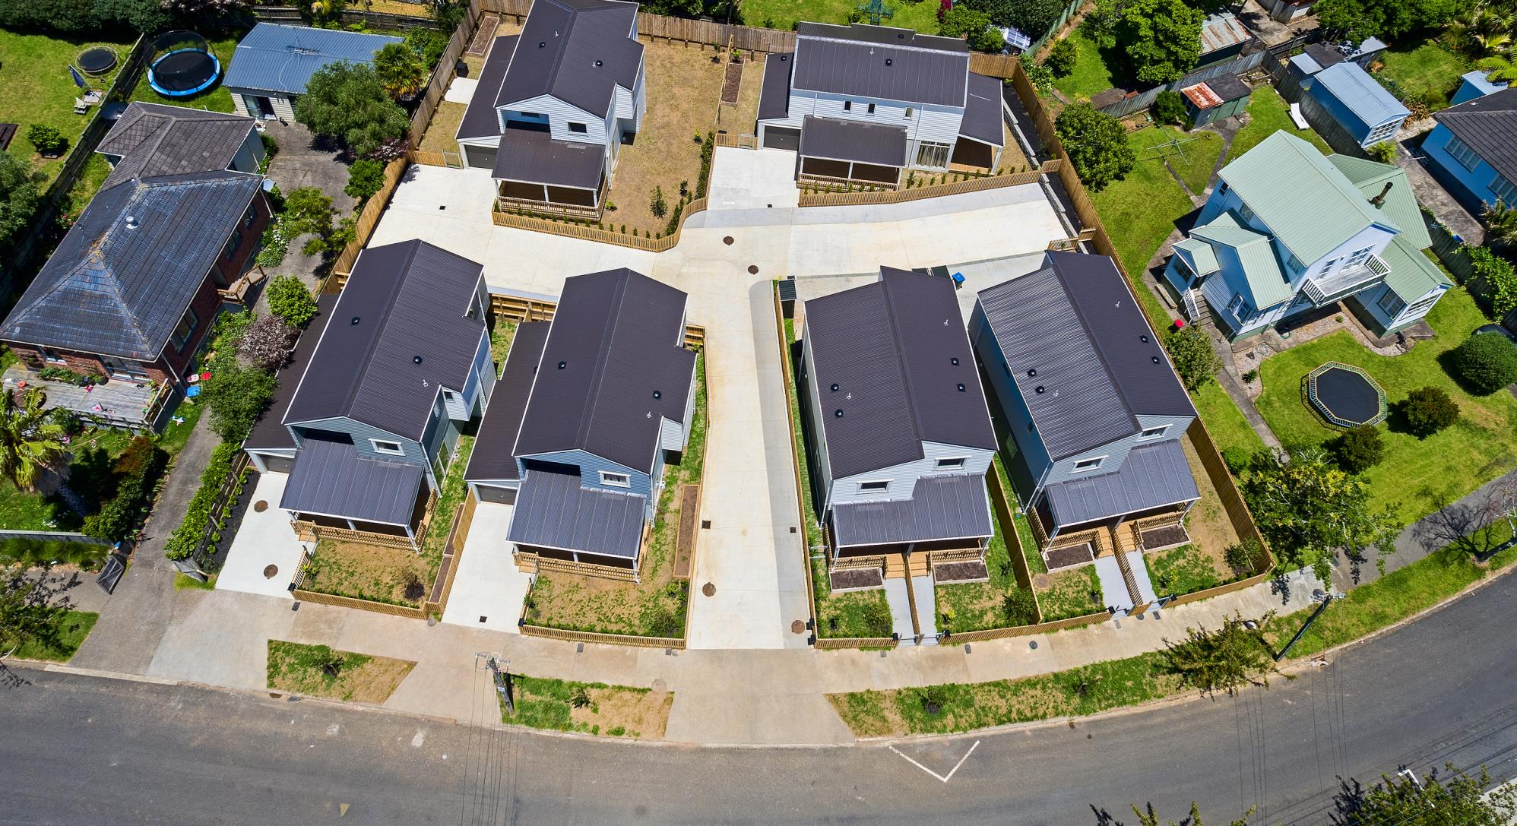
Housing New Zealand developments in Meadowbank
Update to Meadowbank St John’s Residents Association, August 14, 2018

Slide 2
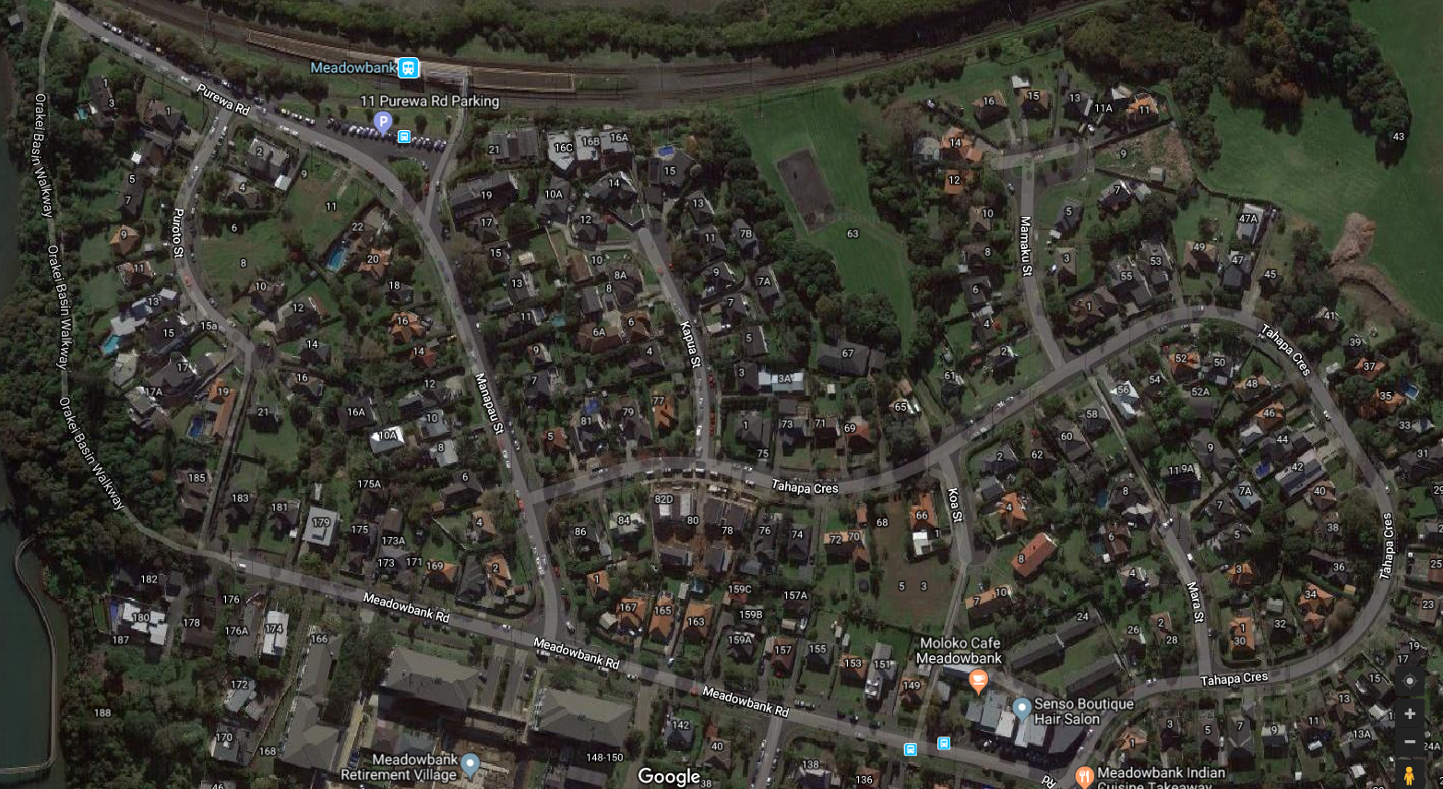
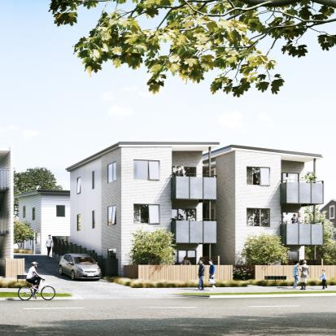
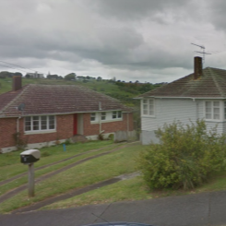
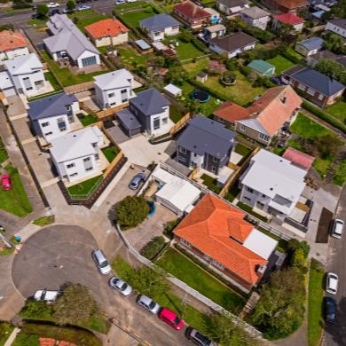
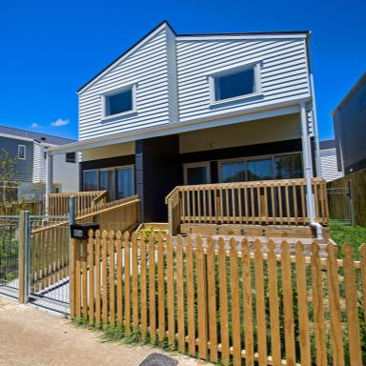
Developments in Meadowbank
9-11 Purewa Rd:
Two homes to be replaced with 11 new homes
6-8 Puroto St:
Plans to be
confirmed
3-5 Koa St/68 Tahapa Cr:
Three homes replaced with nine new homes
78 – 82 Tahapa Cr:
Three homes replaced with eight new homes

Slide 3
Deciding on housing
Housing New Zealand decides on whether to redevelop and what to build on a site-by-site basis.
Critical factors include:
Demand (from the MSD waiting list and internal transfers), including the number of bedrooms
Zoning
The size and shape of the lot
Proximity to schools, hospitals and public transport
Generally speaking, older homes on large sections are the best candidates for redevelopment.
There is potential for more development in Meadowbank in future.

Slide 4
The need for intensification
Demand for state housing in Auckland has doubled in two years, with 3286 families or individuals needing housing support as of March 2018.
State housing waiting list for Auckland
MSD state housing waiting list
Source: Ministry of Social Development Housing Register

Slide 5
Demand by home size
Auckland housing demand by number of bedrooms
5+
3
1
2
Source: Ministry of Social Development Housing Register

Slide 6
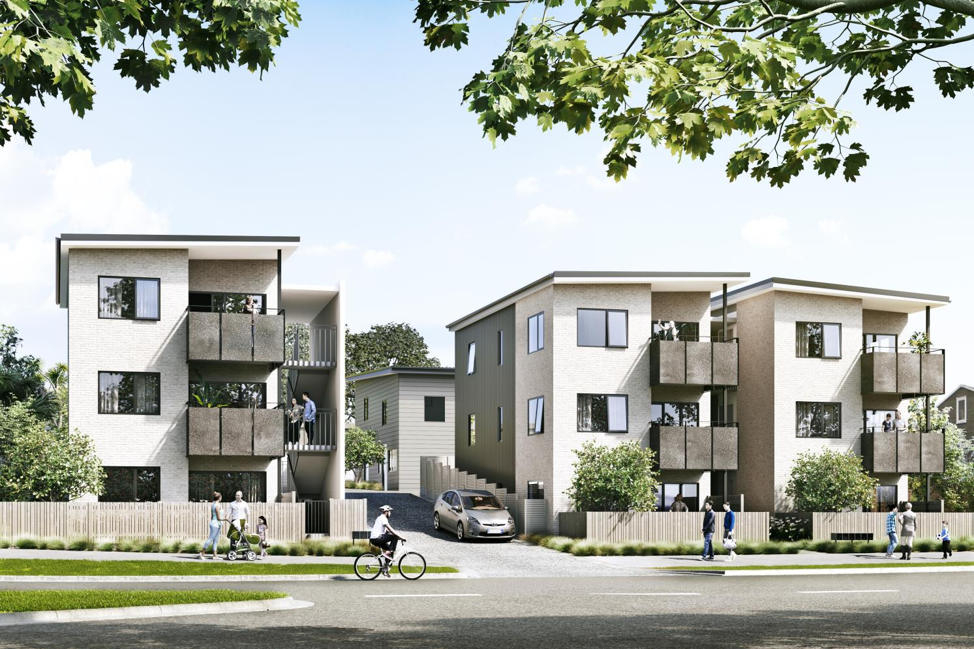
9 – 11 Purewa Rd

Slide 7
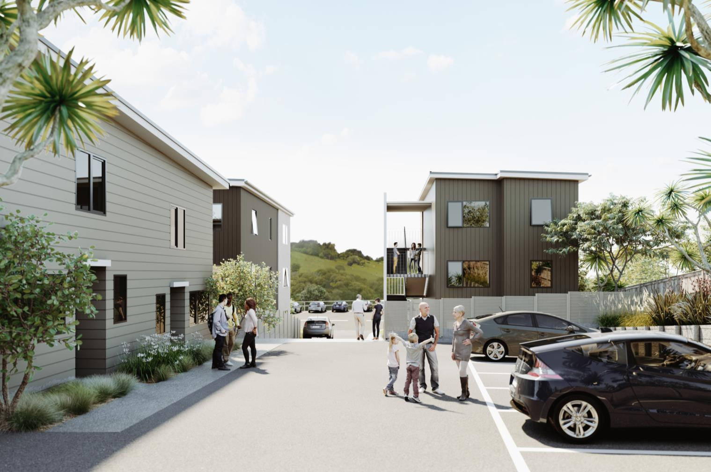
9 – 11 Purewa Rd

Slide 8
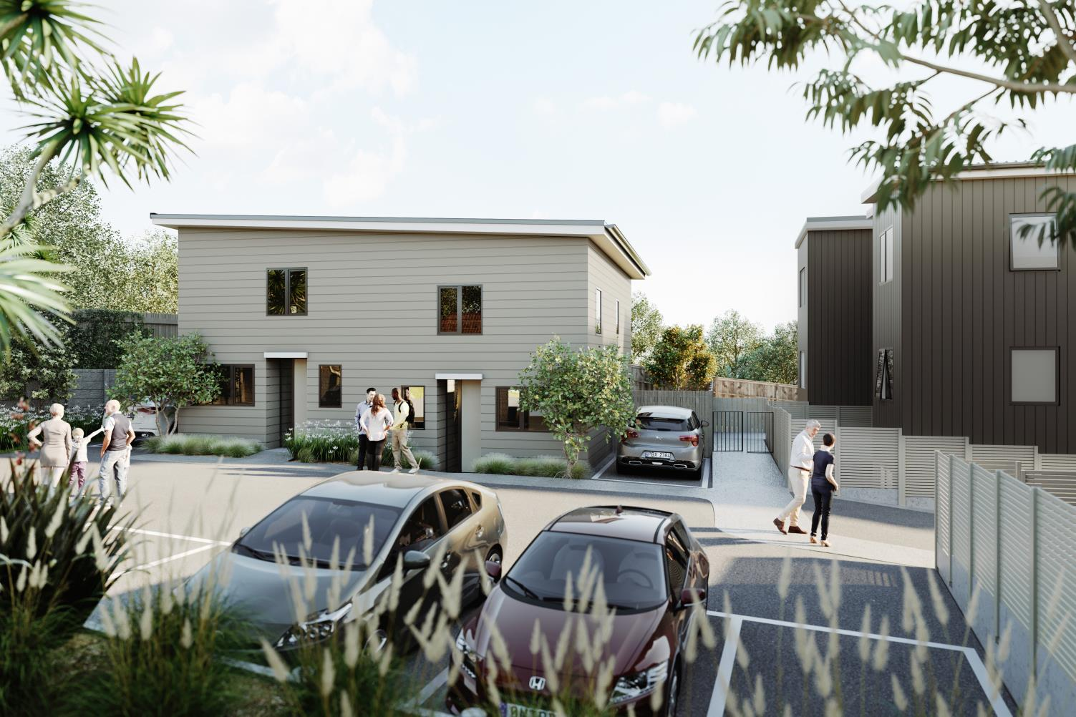
9 – 11 Purewa Rd

Slide 9
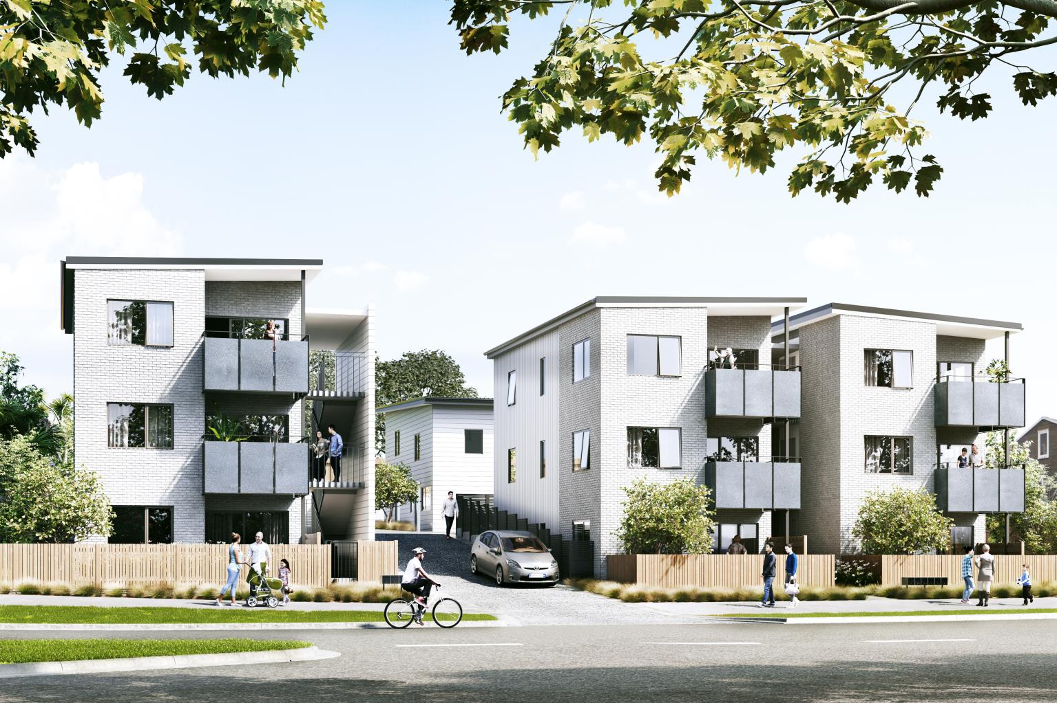
9 – 11 Purewa Rd plans
There were two homes on a 1260m2 site
They will be replaced by 11 new homes built, made up of:
  Two 2-bedroom duplex homes and
  Nine 2-bedroom apartments within three 3-storey walk-up buildings.
Site works will begin in September. Construction is expected to begin in late 2018.
The land is zoned Mixed Housing Urban
This means Auckland Council anticipates “development typically up to three storeys in a variety of sizes and forms, including detached dwellings, terrace housing and low-rise apartments”.
Resource consent was granted earlier this year

Slide 10
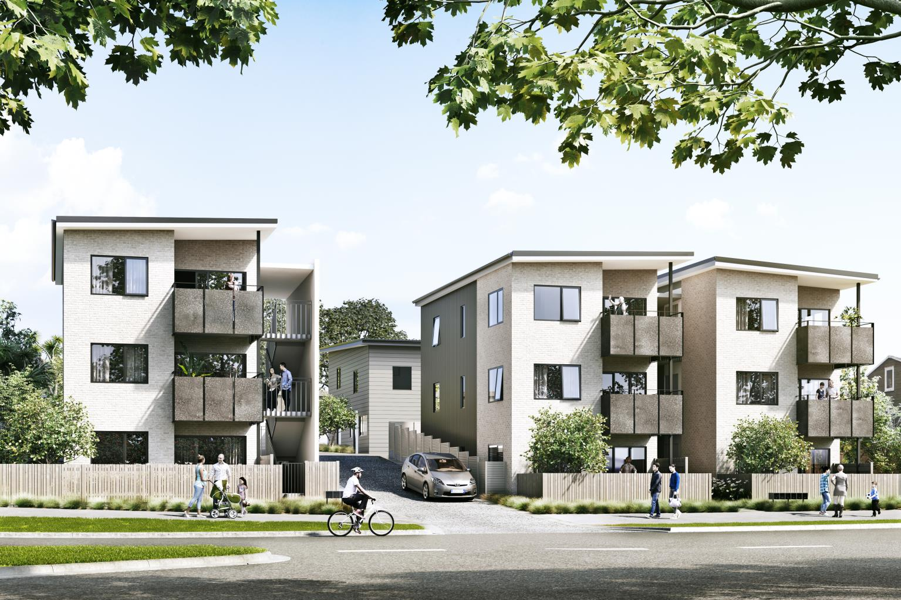
9 – 11 Purewa Rd plans
Civil works will commence in late September 2018 and run through to February 2019.
The building works will be staged. They will start in December 2018 and construction will hit the halfway mark about June 2019.
We expect the properties will be completed with CCC in October 2019.
All timeframes are subject to change due to adverse weather and other variables.

Slide 11
9 – 11 Purewa Rd: urban design elements
Building footprints are stepped along the street to provide relief and reduce the perceived scale of the buildings
Brick cladding provides a sense of solidity and permanence
All apartment living areas are oriented north + north west
Rubbish bins are screened behind fences

Slide 12
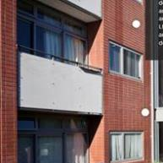
9 – 11 Purewa Rd: urban design elements
Balustrades to all common areas provide vision for safety
Balustrades around private balconies have solid panels to provide privacy and screen residents' belongings
Balcony panels will be tidy and durable
Pedestrian entry from footpath

Slide 13
9 – 11 Purewa Rd, design feedback
HNZ met with architects from The Development Collective, engaged by local residents, to discuss the buildings’ design.
Their feedback was:
Partly fill the exposed external stairwells with stained timber slats, or linear panels
Soften the exterior appearance by adding random panels
Planter boxes or timber for the balcony edges, rather than a compressed sheet
Concrete aggregate driveway
Timber feature shutters on the front windows
Remove or downsize the rear homes to increase play space
Place bins at the rear of the property
Visitor parking, and driveway gates for safety

Slide 14
9 – 11 Purewa Rd, design feedback
We reviewed the feedback, and considering changes around the treatment of exposed stairwells to balance the tenant safety and aesthetic considerations.
We could not remove or downsize the rear building as it would reduce the number of homes/bedrooms available to people in need. This rules out increases in parking and recreational space.
Some of the feedback, such as the aggregate driveway and gates separating homes from the driveway, were already in the design.

Slide 15
Thank you
Your point of contact from here is
Marion Humphrey
021 471 904
marion.humphrey@hnzc.co.nz
Please let me know your questions.

